Slide 1

US Permanent Visa Applications

Slide 2


Agenda
Purpose of the project
Data overview
Exploratory analysis
Classification attempts
Classification results
Issues faced
Summary

Slide 3
Purpose
What we wanted to know
Is it possible to determine if an applicant pursuing a permanent work visa in the United States will be accepted or denied using applicant’s available information
What data was used
Data from the US Department of Labor obtained via Kaggle
US Permanent Visa Applications

Slide 4
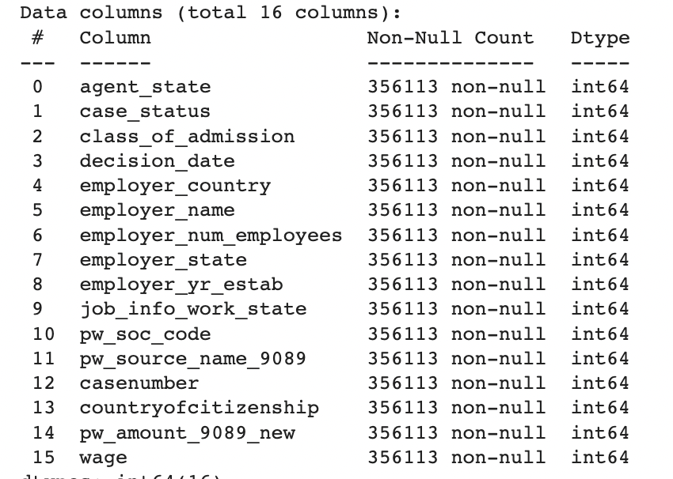
Data Overview
Unprocessed Original Data
374362 observations
154 fields
After data clean-up and removal of unnecessary fields, we reduced it down to
356113 observations
16 fields

Slide 5
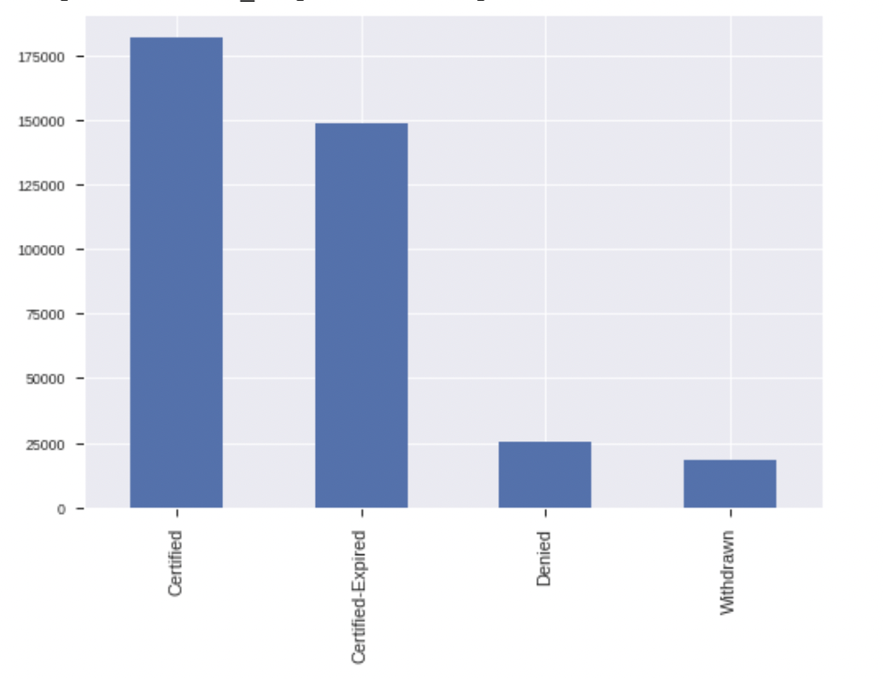
EXPLORATORY ANALYSIS

Slide 6
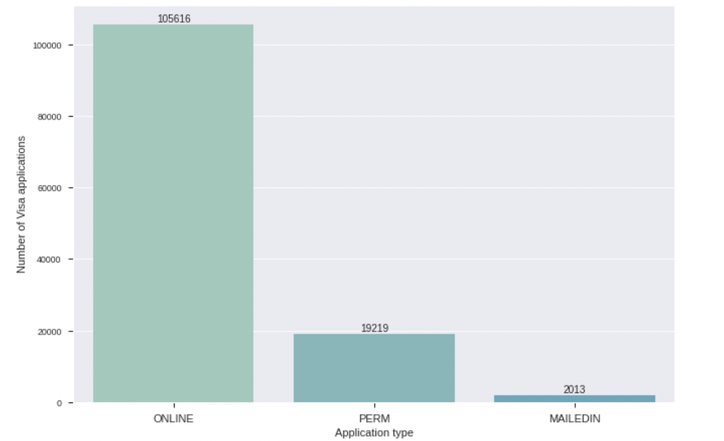
EXPLORATORY ANALYSIS

Slide 7
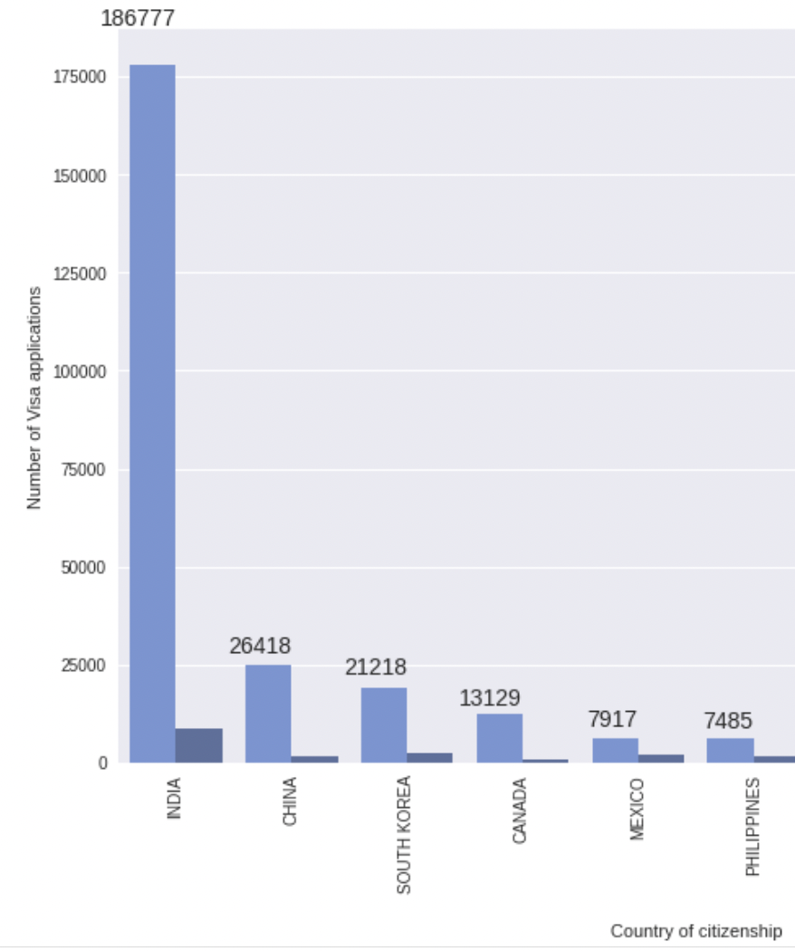
Exploratory Analysis
Most applicants processed are from India
Second most is from China (with South Korea close behind)
The ratio of accepted vs. denied across countries is relatively the same (# of accepted / # denied per country is shown on the graph)

Slide 8
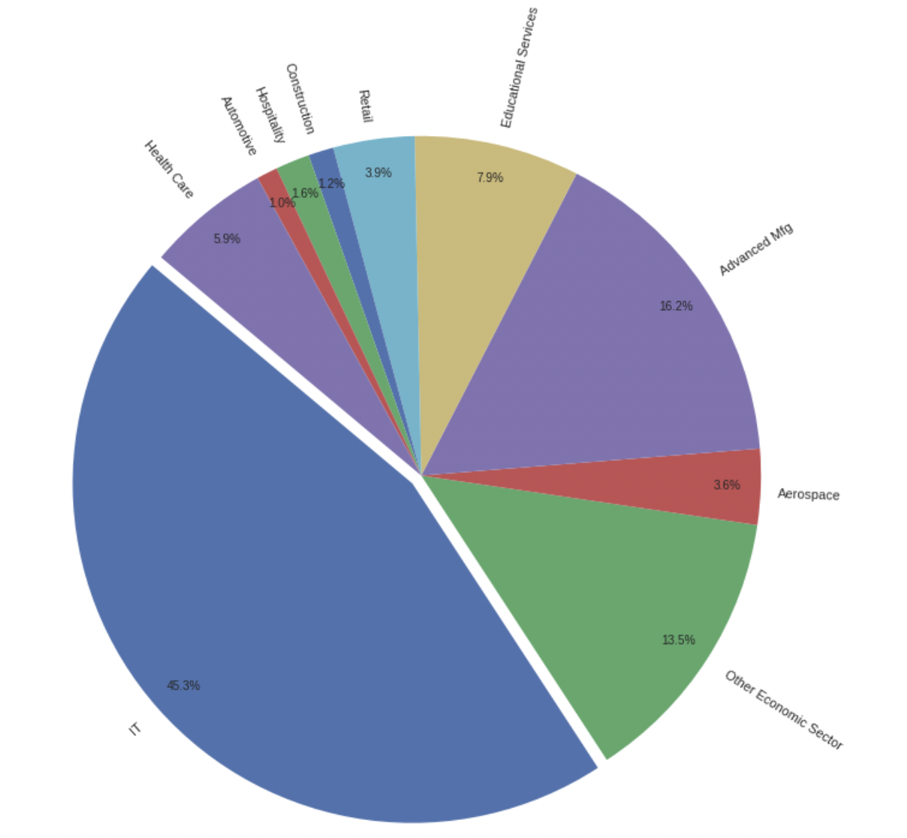
EXPLORATORY ANALYSIS

Slide 9
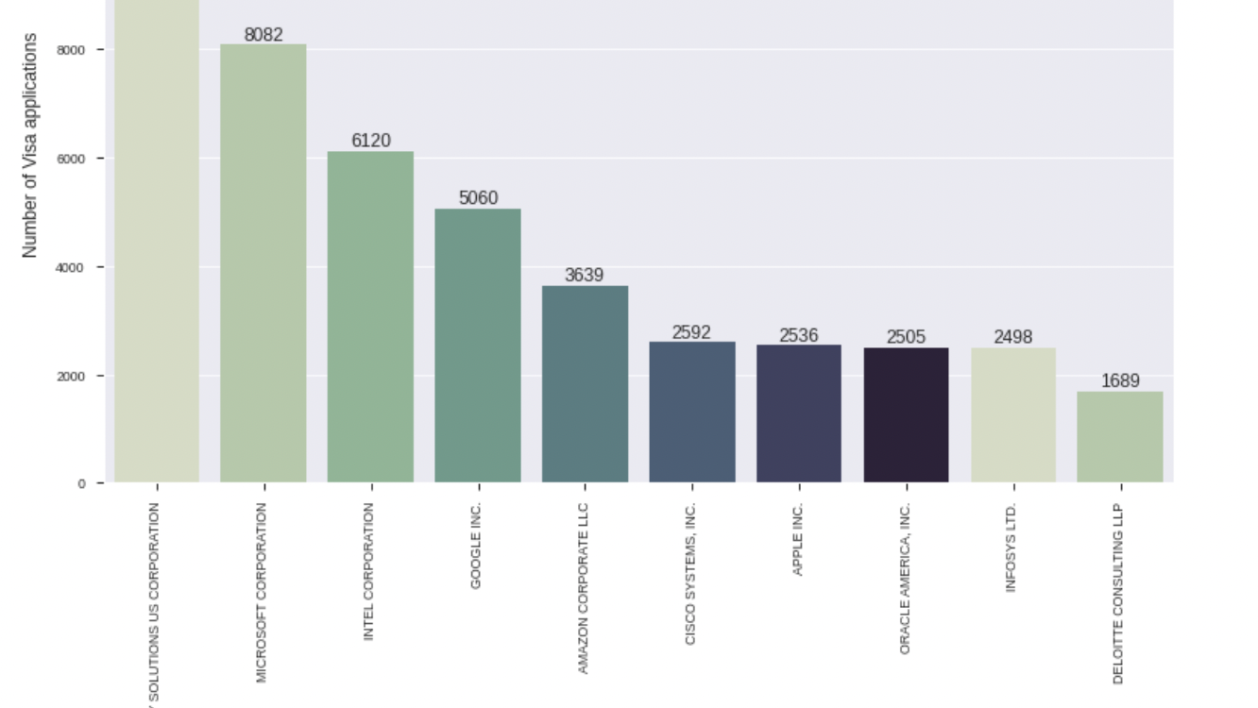

Slide 10
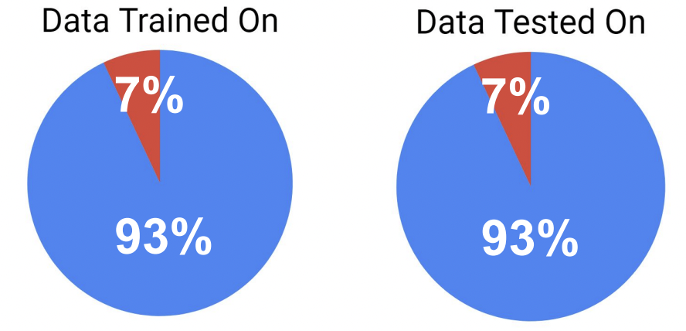
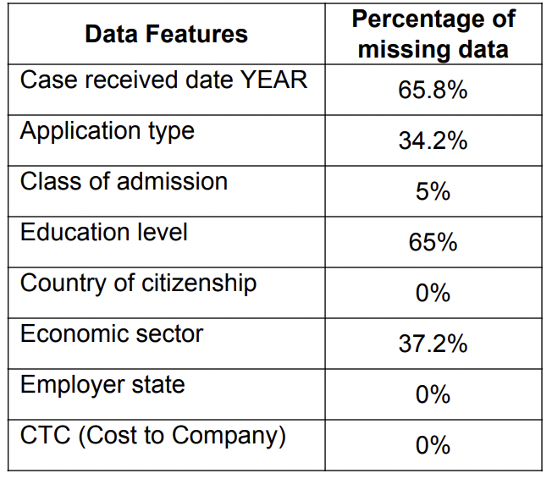
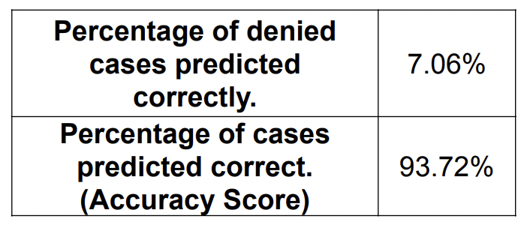
Classification Attempts (Initial Attempt)
Splitted the training and testing sets 70-30%
Got an accuracy of 93% while training using Decision Tree
But realized we have massive over-sampling of “Accepted” cases in our dataset.

Slide 11
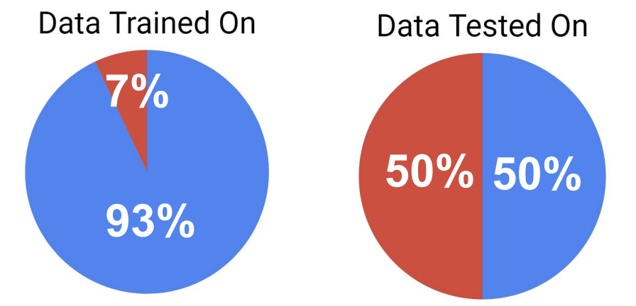
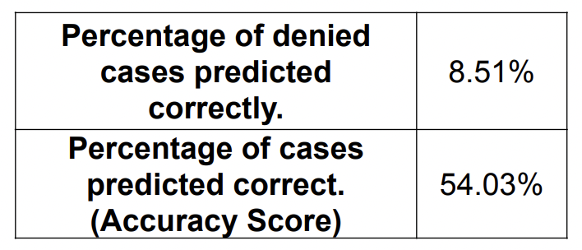
Classification Attempts (Continued)
Tested the same classifier from previous slide on an evenly sampled set of data, We can see that we’re actually doing a little better on Percentage of denied cases predicted correctly

Slide 12
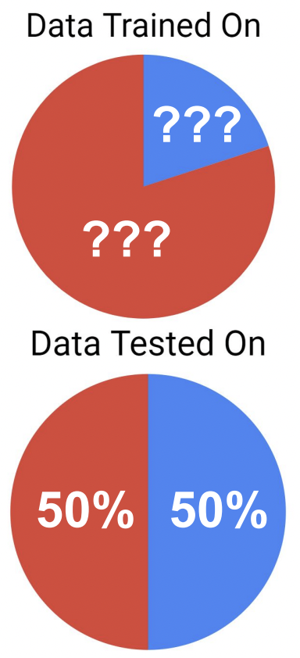
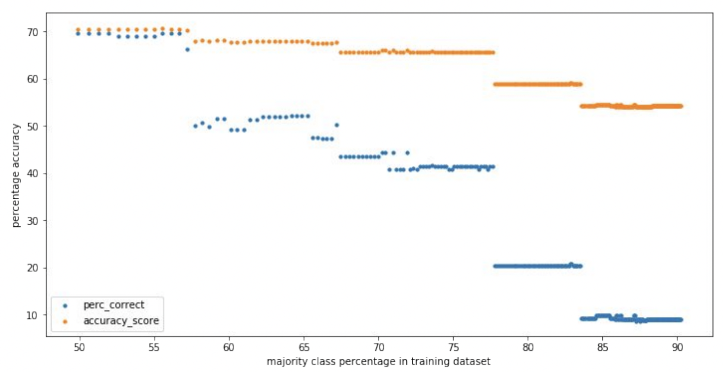
Classification (Sampling Problem)

Slide 13
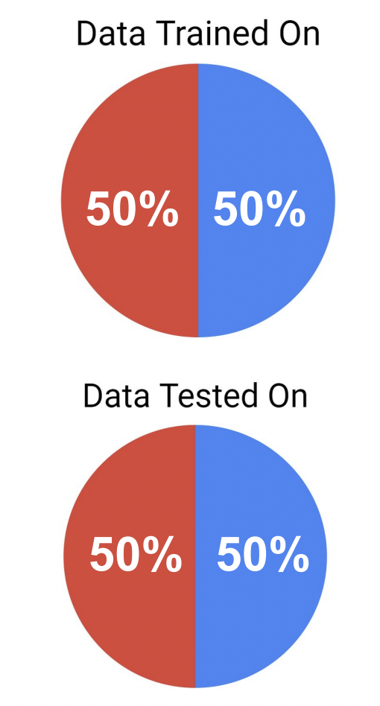
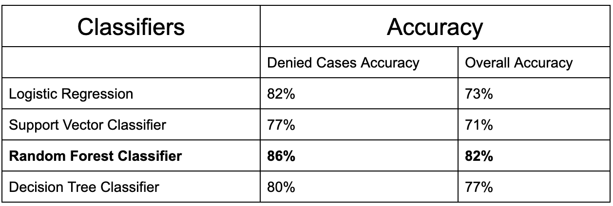
Classification Results (Continued)
Undersampling the dataset and training on evenly distributed data helped in solving the problem of overfitting.
Trained on four classifiers and Random Forest classifier got the highest accuracy of 82% and accuracy for denied cases 82%.

Slide 14
Issues Faced
Issue | Solution Implemented
Huge data set with many fields | Removed fields which were not helpful.
Redundant Fields | Merged them into one.
Ample number of empty, NA or 0 data | The fields that were numeric and empty was filled with average value of that field over the whole dataset. Rest were filled with NONE.
Poor ratio of accepted visa applicants to denied ones.(10.875:1) over the entire dataset. | As test data we took 1:1 ratio of accepted and denied applicants to train the classifier and used this to create prediction on rest of the data.

Slide 15

Summary

Slide 16



THANK YOU

